Slide 1
Skyway Management : Tenant Maintenance
Request Portal
Siddharth Rayabharam
Abhinav Vij

Slide 2
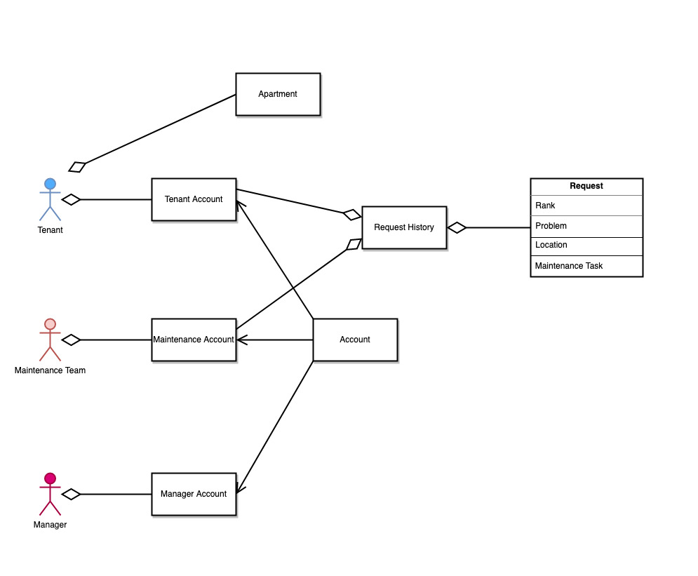
DOMAIN
MODEL

Slide 3
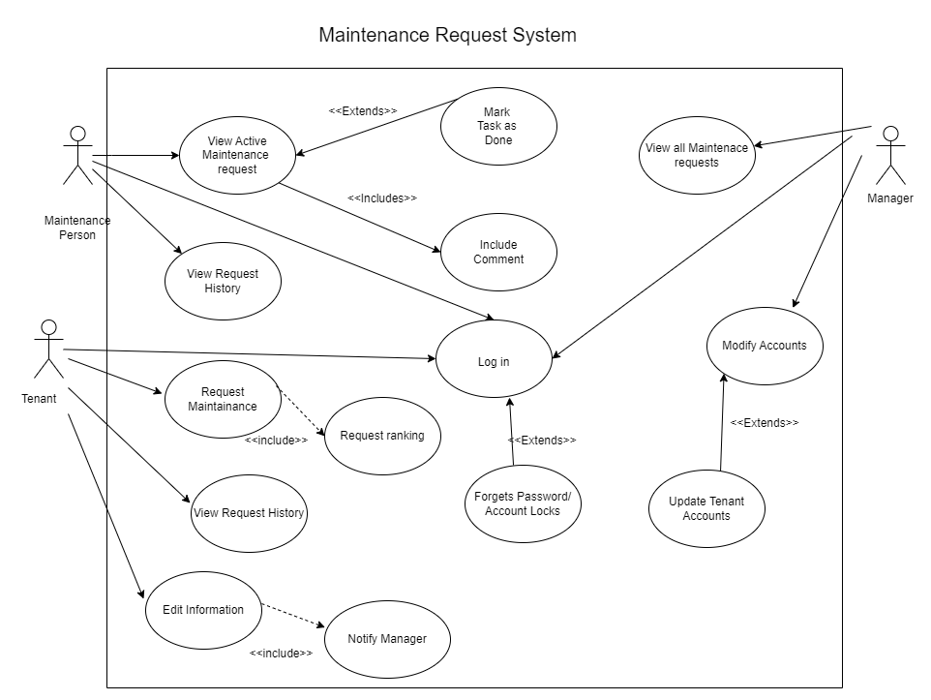
USE
CASE
MODEL

Slide 4
Features Implemented
​Tenant, manager and maintenance teams can login
Implemented Home, Contact, About page for Website
Tenant can create a new maintenance request
Maintenance team can complete a pending request
Manager can view all the request history

Slide 5
Technology Used
React
SpringBoot
MySQL

Slide 6
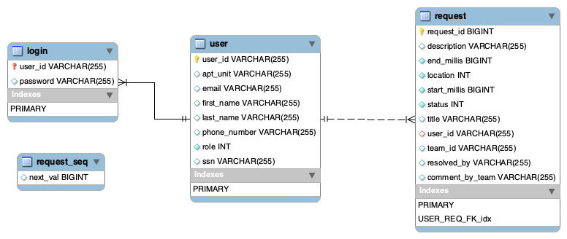
DATABASE

Slide 7
THANK YOU

